Slide 1


MANUFACTURING INTELLIGENCE
Performance & Downtime Analysis Journey for Aquafizz Industries
Transforming Raw Data into Proactive Strategic Insights

Slide 2

The Operational Reality
Why every minute counts in modern manufacturing environments

Slide 3






Team Work
Prepared by

Slide 4


Every minute of production downtime represents a direct loss in factory efficiency
Continuous Operations
The Data Paradox
Machines are running continuously, production lines never stop, and hundreds of batches are produced every shift. But are we achieving peak performance?
Manufacturing environments produce thousands of records. The challenge is not gathering data, but turning it into meaningful decisions.

Slide 5






Six core metrics reveal the hidden story within the production line data
Operating Hours
Downtime Logs
Efficiency Rates
Tracking the total time the floor is active vs. actual production time.
Categorizing every stoppage to identify recurring systemic failures.
Measuring performance against established manufacturing benchmarks.

Slide 6
Six core metrics reveal the hidden story within the production line data
production quantities
Operational losses.
machine performance,
Tracking actual output volume per shift against targets to guarantee seamless supply chain alignment..
Exposing hidden gaps, wasted time, and process inefficiencies that directly drain factory profitability.
Monitoring individual equipment efficiency to deploy targeted preventive maintenance before critical failures occur.

Slide 7
The Data Journey
From Raw Manufacturing Logs to Operational Intelligence

Slide 8
Our structured analytical process follows four phases to ensure high data reliability
Collection
Cleaning
Analysis
Visualization
Gathering logs from production lines, batches, and operator records.
Removing duplicates, fixing missing values, and formatting inconsistencies.
Processing KPIs like production trends and machine performance levels.
Building interactive Power BI dashboards for real-time decision support.

Slide 9

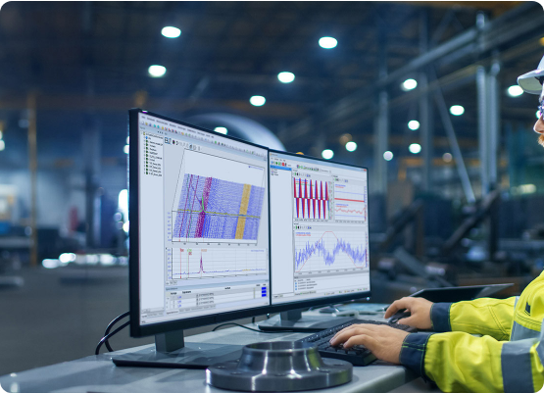
Rigorous cleaning turns raw records into reliable business insights
Eliminated Noise: Managed duplicate records and inconsistent formatting.
Unified Data: Standardized time formats across multiple machine sources.
Actionable Structure: Created a linked system for batches and downtime logs.

Slide 10

Interactive Power BI Intelligence
Transitioning from long reports to instant visual insights:
Real-time KPI monitoring
Instant bottleneck identification
Machine performance comparisons

Slide 11
The Proactive Future
Shifting from "What Happened" to "Predicting Next Steps"

Slide 12
Questions?
"The factory speaks through data – are we listening?"
Aquafizz Industries | Operational Intelligence Project 2026

Slide 13

Thanks

